Slide 2
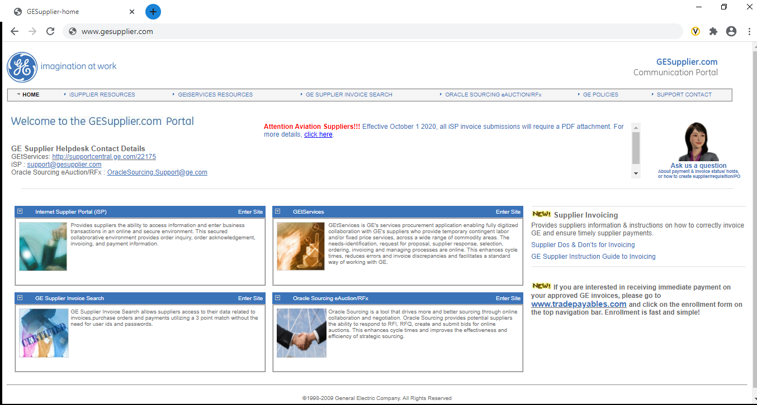
iSupplier Portal Login
Go to http://www.gesupplier.com/

Slide 3
Click on ISUPPLIER RESOURCES
iSupplier Portal Login

Slide 4
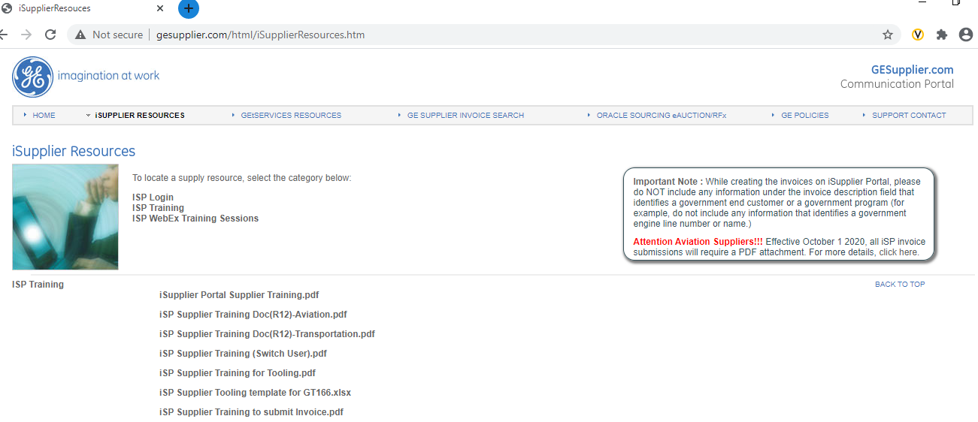
iSupplier Portal Login
Click on ISP Login

Slide 5
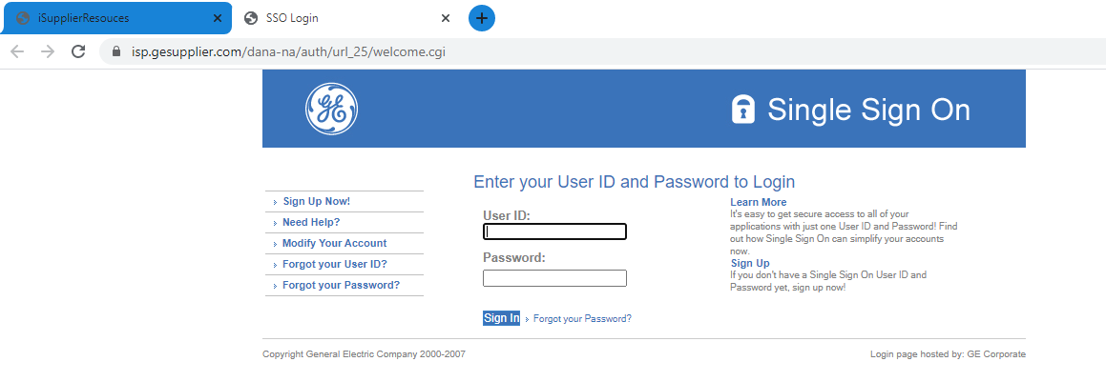
iSupplier Portal Login
Type your SSO id and password
Note: Use your main SSO id

Slide 6
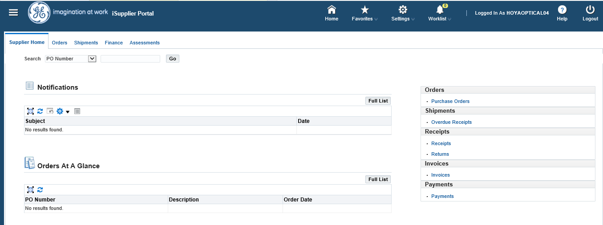
How to switch user accounts ?
Click on Home

Slide 7
Switch user
Click on Switch User

Slide 8
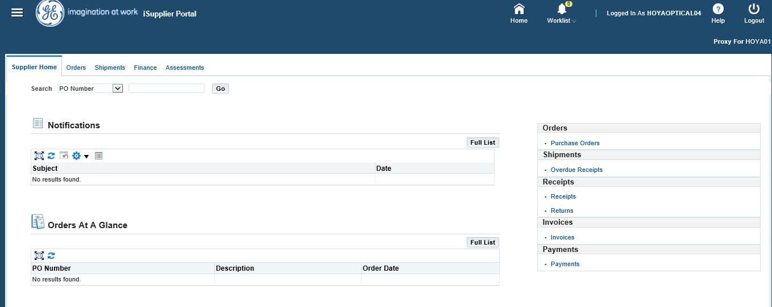
User Switched
It will show you that you have switched user

Slide 9
To switch back to main SSO user
Click on Home

Slide 10
To switch back to main SSO user
Click on Return to Self

Slide 11
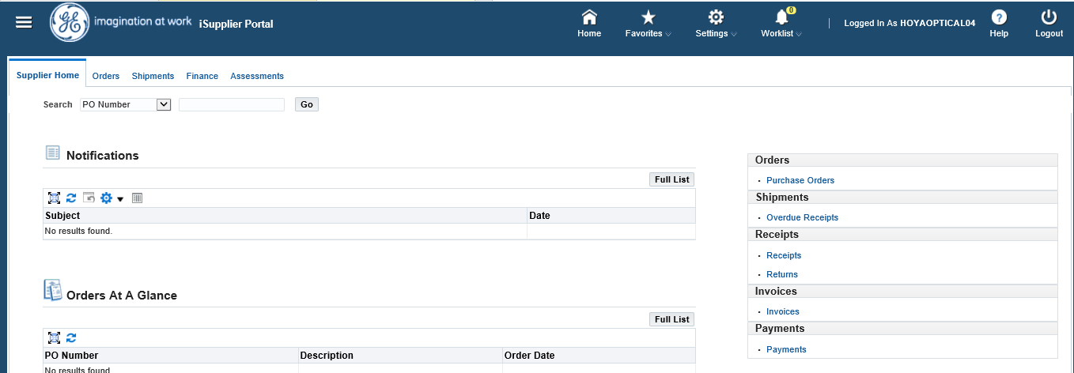
Switched back to main SSO user
Main SSO User

