Slide 1
[Document Title]
NOTICE
The information contained in this document is not to be used for any purpose other than the purposes for which this document is furnished by GENPACT, nor is this document (in whole or in part) to be reproduced or furnished to third parties or made public without the prior express written permission of GENPACT.
Version Control
Version No. | Date | Type of Changes | Owner/ Author | Date of Review/Expiry

Slide 2
GE Supplier Portal Login Navigation Details

Slide 3
INDEX Get services Login iSupplier Portal Login Oracle sourcing eAuction/RFx (CSS) LOGIN

Slide 4
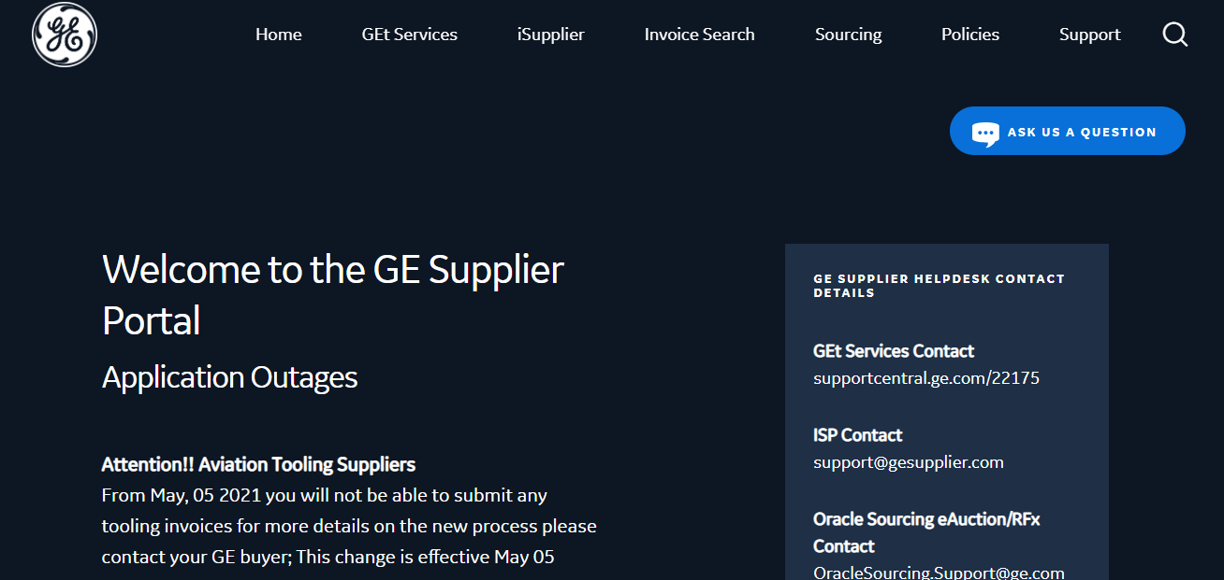
GET services Login
Click on Get services

Slide 5
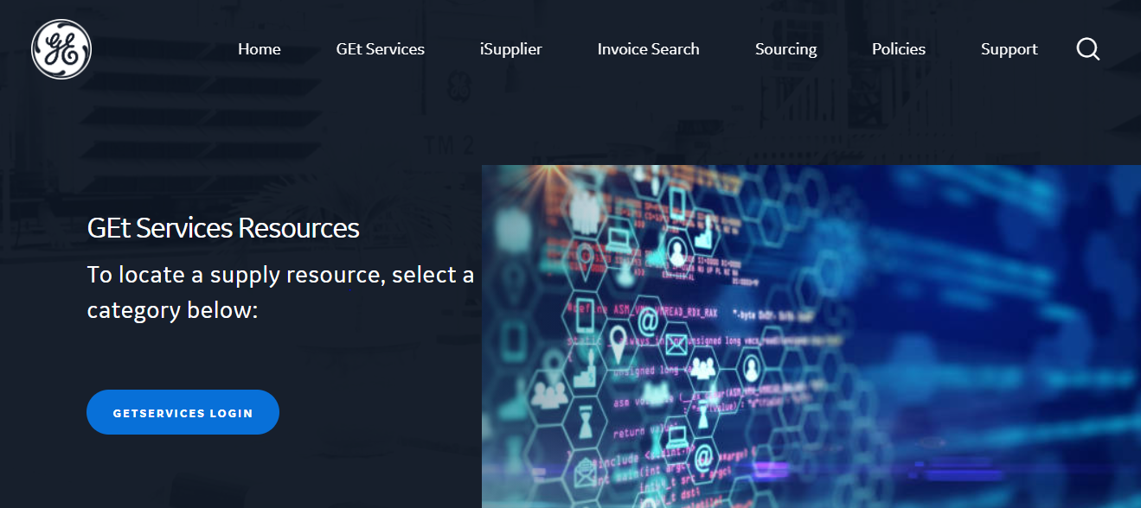
GEtservices Login
Click on GETSERVICES LOGIN

Slide 6
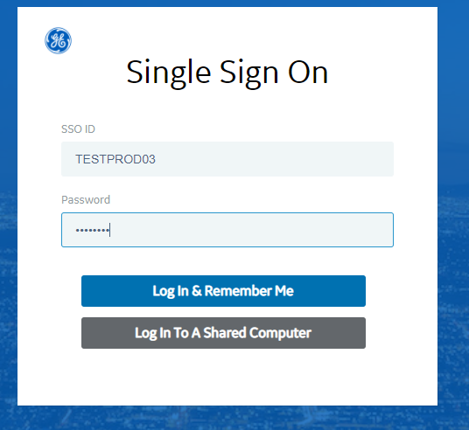
Login page for Getservices
Enter your SSO id and password
And click on log in

Slide 7
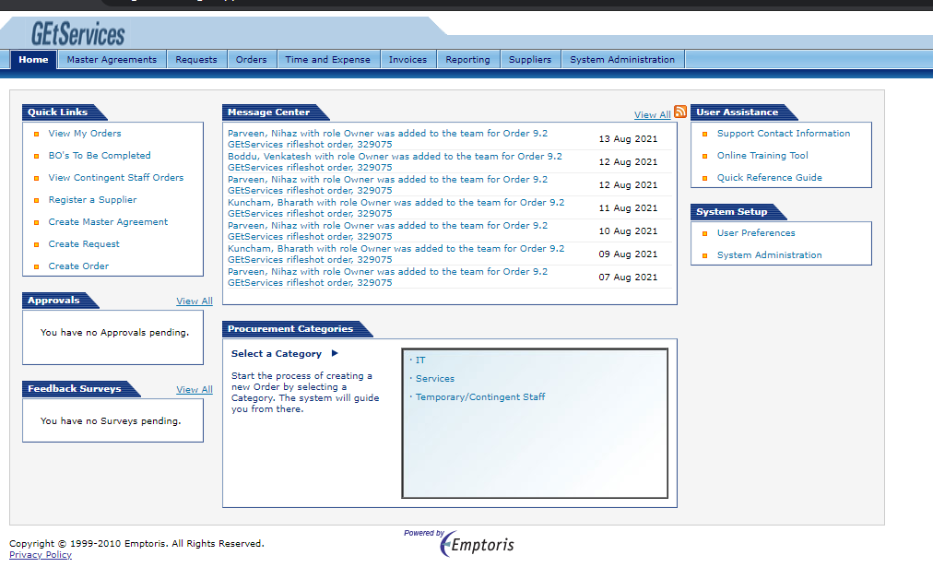
Get services home page

Slide 8
iSupplier Portal Login
Click on ISupplier

Slide 9
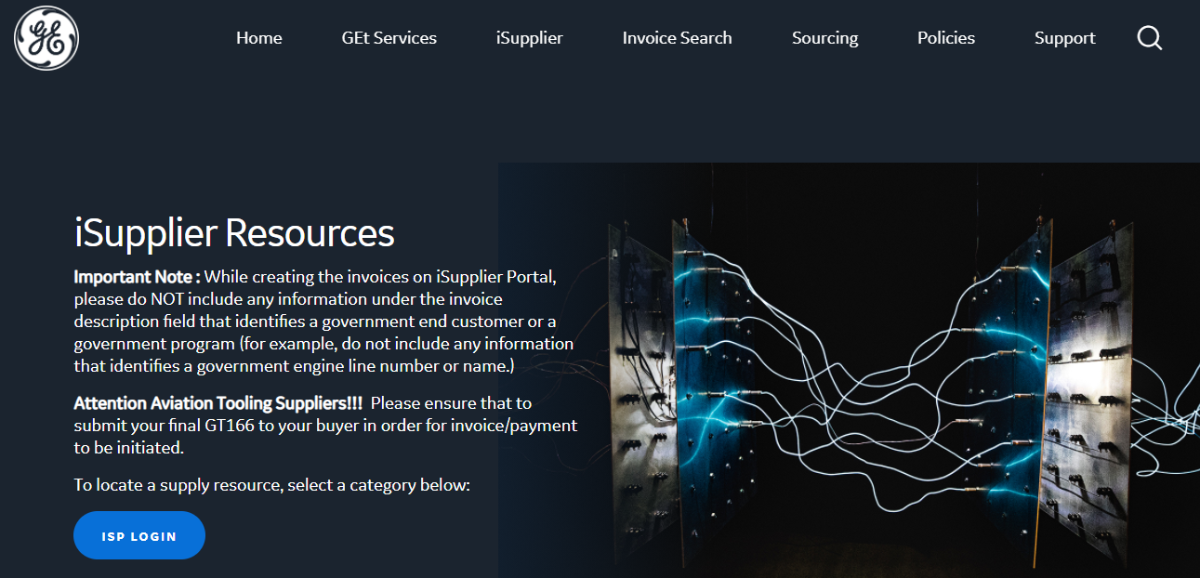
iSupplier Portal Login
Click on Isp login

Slide 10
iSupplier Portal Login
Enter your SSO id and password
And click on log in

Slide 11
Supplier home page
Click on Home

Slide 12
ISP home page appears as below

Slide 13
Oracle sourcing eAuction/RFx (CSS) LOGIN
Click on Sourcing

Slide 14
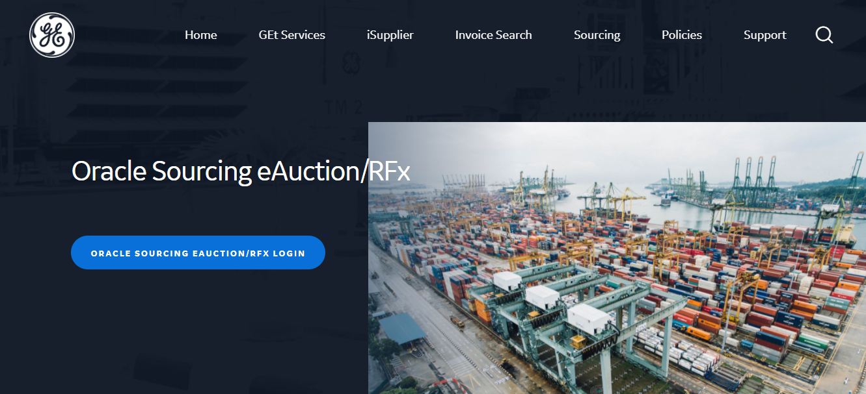
Click here
Oracle sourcing eAuction/RFx (CSS) LOGIN

Slide 15
Login page
Enter your SSO id and password
And click on log in

Slide 16
Sourcing Supplier Home page

Slide 17
Thank you

